Slide 1
International Financial Management
(Financial risk management)
Dr. Jean-François Verdié
Professor, TBS Education jf.verdie@tbs-education.fr

Slide 2
Course Overview
Course Objective
  To provide a framework for making financial decisions in an international context.
Related topics
  Corporate Finance : investing and financing
  Risk management
  International financial macroeconomics
  Multinational business
  Geopolitics

Slide 3
Course Overview
Foreign
Exchange
Markets
Sourcing
Capital in
Global Markets
International
Financial
Management
Case method
Synthesis
Managing
FOREX
Exposure
Foreign
Investment
Decisions

Slide 4
FOREIGN EXCHANGE RISK
INDICATIVE SOURCES
  L. COPELAND, EXCHANGE RATES AND INTERNATIONAL FINANCE, ADDISON WESLEY,1995.
  D.K. EITEMAN / A.K. STONEHILL / M.H. MOFFETT, MULTINATIONAL BUSINESS FINANCE, PEARSON INTERNATIONAL EDITION, 13TH EDITION.
  European Central Bank : www.ecb.int/
  Bank of International Settlements: www.bis.org/
  International Monetary Fund: www.imf.org/
  NYSE EURONEXT LIFFE : www.euronext.com/
  ISDA http://www2.isda.org/ (International Swaps and Derivatives Association).
  LVMH https://www.lvmh.com/investors/profile/financial-indicators/#groupe

Slide 5
Assessment
Academic paper to summarize from www.ssrn.com/ (groups of 2 students, deadline 26th of janvuary, Campus) : 50%.
  Paper to select related to the course (validation is required)
  Summary of the paper : ppt pitch
    Use www.ssrn.com/ : web site of working paper (search by keywords)
    Title and full reference
    Objectives of the paper
    Methodology used
    Results and discussion for further research
Short case to solve during the last session (50%) and to send to jf.verdie@tbs-education.fr

Slide 6
What is special about international finance?
Foreign exchange risk
  E.g., an unexpected devaluation or depreciation adversely affects your export market…
Political risk (country risk, sovereign risk)
  E.g., an unexpected overturn of the government that influences existing negotiated contracts…
Market imperfections
  E.g., trade barriers and tax incentives may affect location of production, lack of liquidity on some financial markets may affect the cost of capital …
Expanded opportunity sets
  E.g., raise funds in global markets, gains from economies of scale or scope, more risks/more expected returns …

Slide 7
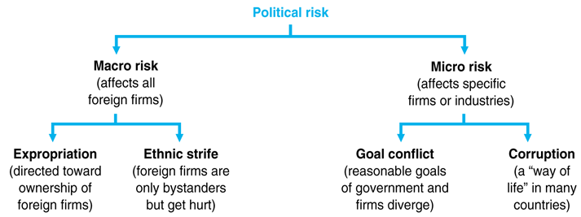
Decomposition of Political Risk

Slide 8
EMU and EURO: a specific framework
The FER is determined by international economics and politic conditions
EXCHANGE RATE REGIMES (régimes de changes)
  PURE FLOAT: changes flexibles ou flottants.
  MANAGED «DIRTY» FLOAT : changes fixes non officiels.
  CRAWLING PEG SYSTEM: changes fixes officiels (European Monetary System 1 and 2).
  FIXED RATES: England/Scotland.
  MONETARY UNION: Zone Monétaire (EMU).

Slide 9
EMU and EURO: a specific framework
WHAT IS A MONETARY UNION ?
  R. MUNDELL, 1961, NP1999.
  A SINGLE CURRENCY ZONE OR MONETARY UNION IS ONE WHERE THE ACCEPTED MEANS OF PAYMENT CONSISTS EITHER OF A SINGLE, HOMOGENEOUS CURRENCY, OR OF TWO OR MORE CURRENCIES LINKED BY AN EXCHANGE RATE WHICH IS FIXED IRREVOCABLY
  See L. COPELAND, chapter 10.

Slide 10
SHORT QUIZ
1) Which assumption is not linked with the Optimum Currency Area Theory?
a. The asymmetric shocks should be the same for all the member states
b. The economies should be in line (quite the same growth rate)
c. Labor market mobility is not allowed in an Optimum Currency Area
d. The structure of the economies should be the same

Slide 11
SHORT QUIZ
2) Within the European Monetary Union, you presently have:
a. 12 countries
b. 15 countries
c. 19 countries
d. 20 countries

Slide 12
SHORT QUIZ
3) What currency is pegged with the US Dollar?
a. Euro?
b. Yuan from China?
c. Great Britain Pound (GBP: Sterling)?
d. Japanese Yen (JPY)?

Slide 13
SHORT QUIZ
4) In a fixed exchange rate mechanism (fixed ERM), all participating currencies should be under control of:
a. the Government of each member state?
b. the International Monetary Fund?
c. the Bank of International Settlements?
d. the Central Bank(s) of the area?

Slide 14
SHORT QUIZ
5) Among the following criteria, which one is not linked with the Maastricht Treaty?
a. Public deficit?
b. Unemployment rate?
c. Inflation rate?
d. Long term interest rates?

Slide 15
Managing Risk: Shareholder Value and Risk
To which risks a business can be exposed?
  Cash shortfalls
  Financial distress
  Variable costs (raw materials, commodities)
  Currency fluctuations
  Interest rates (debt refinancing)
  Political instability
  Weather changes
  Environmental regulations
  Strikes
Business Risks (variable costs, competition, industry, technology) Financial Risks (interest rates and currency changes)
Markets risks impact financial performance through a variety of drivers that determine:
cash flows
earnings per share
balance sheet ratios

Slide 16
Risks in international finance
Quotes from BIS, Core principles for effective banking supervision,
See also: Basel II: International Convergence of Capital Measurement and Capital Standards: A Revised Framework, http://www.bis.org/
Credit risk
Country and transfer risk
Market risk
Interest rate risk
Liquidity risk
Operational risk
Legal risk
Reputational risk

Slide 17
International Financial Management
Part 1: Foreign Exchange Risk and Markets
Part 2 : International Financing
Part 3 : Country Risk (Embratel case)

Slide 18
PART ONE
FOREIGN EXCHANGE RISK AND MARKETS
Dr. Jean-François VERDIE
Professor, Economics/Finance Department
Toulouse Business School, France. jf.verdie@tbs-education.fr

Slide 19
FOREIGN EXCHANGE RISK
CONTENT
WHAT IS FOREIGN EXCHANGE RISK
FOREX VOLATILITY https://www.boursorama.com/bourse/devises/taux-de-change-euro-dollar-EUR-USD/
STRATEGIES TO MANAGE THE FER

Slide 20
Managing Risk: Identifying FX Risk
What is FX Risk?
What should we know about the company to identify its FX risk?
  What is the sales breakdown (currency) and annual budget?
  What are the main costs?
  What is the trade balance of the company?
  What is the debt structure (currency, fix/floating rate and tenor)?
  Does it have any foreign subsidiaries or plans to expand abroad?
  Does the company repatriate dividends from foreign operations?
  Does the company have excess liquidity and in which currency?
  Who are the main competitors? (eg: Airbus et Boeing)
  What were the impacts of the recent FX volatility on its financial statements?

Slide 21
Managing Risk: Identifying FX Risk
Types of FX exposure
  Cash flows: Imports vs. exports
  Liabilities in different currencies
  Assets / subsidiaries in another country
  CAREFUL with Hidden risks:
    Costs indexed to another currency
    Competitors
Impacts of FX Exposure for the company
  Operational => impacts on cash flows, EBITDA, operating and financial margins, competitiveness
  Economic => effects on firm‟s value (net worth)
  Accounting => implications on financial statements (covenants, credit rating)
Can we know the future? Is there a way to limit the uncertainty?

Slide 22
Managing Risk: Hedging
Should a company eliminate all risks?
  Business and operating risks
    Shareholders want a company to take some risks ex: oil extraction company vs. Airline company
  Financial risks
    Shareholders care about future profits and stable returns
What is Hedging?
  A risk management strategy used in limiting or offsetting the probability of loss from
fluctuations in the prices of commodities, currencies, interest rates or securities.
  A transfer of risk without buying insurance policies.
  It involves taking equal and opposite positions in financial markets through various instruments: derivatives.

Slide 23
FOREIGN EXCHANGE RISK
THE HIDDEN DANGER !
British exporter case: GBP (Sterlin)
USD tender (bid): 2 Millions

Slide 24
FOREIGN EXCHANGE RISK
MEASURING FER
(exposition au risque de change)
ECONOMIC EXPOSURE or POSITION
ACCOUNTING EXPOSURE or POSITION
TRANSACTION EXPOSURE or POSITION

Slide 25
FOREIGN EXCHANGE RISK
ECONOMIC POSITION
CURRENCIES FLUCTUATIONS IMPACTS AND FIRM ’S VALUE OR PROJECTS NPV
ACCOUNTING POSITION
CURRENCIES FLUCTUATIONS AND FINANCIAL STATEMENTS

Slide 26
FOREIGN EXCHANGE RISK
TRANSACTION POSITION
  OBJECTIVE = QUANTIFY THE FOREIGN EXCHANGE EXPOSURE FOR COMMERCIAL/FINANCIAL TRANSACTIONS (exports, imports, loans, deposits …).
  REGISTER THE POSITIONS USING THE BALANCE SYSTEM.
  CALCULATE THE NET POSITION
  QUALIFY THE NET POSITION
    CLOSED / OPENED
    LONG / SHORT

Slide 27
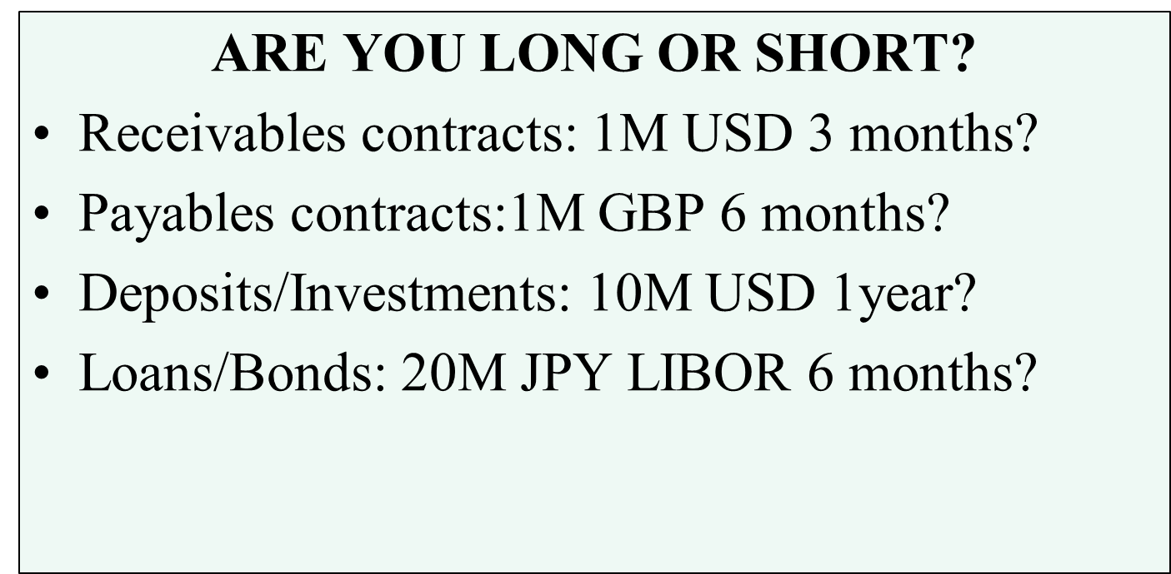
Transaction exposure or position

Slide 28
Covered Exposure
If the exposure to foreign exchange risk is completely eliminated through hedging, then the exposure is covered.
net position = 0.
currency balance is closed.

Slide 29
MANAGING FER
STRATEGY
3 CHOICES DEPENDING ON RISK AVERSION OR TOLERANCE
  HEDGING (couverture)
  SPECULATION (spéculation)
  SELECTIVE STRATEGY (mix des deux)

Slide 30
Risk Management in pratice
Risk Management Process is based on 3 main areas:
(1) Appropriate risk management strategy, (2) Infrastructure required, (3) Organizational changes
Organizational components
  Determine Management and Committees role
  Define risk exposure
  Establish adequate instruments
A. Structure
B. Procedures
C. Systems
Key procedures
Risk policies
Risk Controls / Limits
Accounting
Fiscal
Systems
Front Office (deal capture)
Middle office (validation, confirmation, payments)
Back office (Accounting,
Taxes, Recons)
Risk analysis
21

Slide 31



Risk Management: Impacts
Risk Committee
Establish objectives and guides
Establish risk limits
Receives anomaly report
CFO
Monitors / exercises limits
Revises reports
Notifies in the event of exceptions
Risk Manager
Develop and implement risk mitigation strategy
Fundamental and technical analysis
Financial structure

Slide 32
Risk Management Policy
Types of Risk and Hierarchy
Steps in developing a risk management strategy:
Identify and measure the exposures
Measure the sensitivity of CF: value at risk model
Determine the tolerance to risk: objectives
List the alternatives: hedging strategy
Implement the hedging: market analysis and timing
Dynamic management of hedging position
Commod
FX
Interest
Equity
Other
RISK ANALYSIS
Benefits of a risk management policy
- Better Financial Planning: Increases certainty of
forecasted profits
RISK MANAGEMENT POLICY
- Cost optimization: Decreases financing cost and improve capital structure
OBJECTIVES
(timing)
TOLERANCE TO RISK
- Improves use of capital and resources through risk analysis/return.
- Increases competitiveness
TOOLS
FEEDBACK

Slide 33
MANAGING FER
TO IMPLEMENT A RELEVANT STRATEGY, YOU NEED ANTICIPATIONS.
TO BUILD ANTICIPATIONS, YOU NEED USEFUL INFORMATIONS (?)

Slide 34
FOREIGN EXCHANGE RATES FORECASTING
FUNDAMENTAL ANALYSIS.
  INTEREST RATES (IRP)
  EXPECTED INFLATION (PPP)
  BALANCE OF PAYMENTS ANALYSIS
  ECONOMIC GROWTH SPREAD
  USD INTERNATIONAL ROLE
  OTHER FACTORS : POLITICAL (polls, Brexit…)
TECHNICAL ANALYSIS eg CHARTISM.

Slide 35
MANAGING FER
CONTRACTS TO MANAGE FER ==> TRADED ON FOREIGN EXCHANGE MARKETS (FOREX)
  OVER THE COUNTER MARKETS (OTC) : marché des gré à gré.
    SPOT (CASH)
    CURRENCIES FORWARD / SWAPS (swaps cambistes)
    CURRENCIES OPTIONS (SINGLE, EXOTIC 1st/2nd generation)
  ORGANISED MARKETS (CBOT, EURONEXT, …) : marchés organisés de produits dérivés à terme et optionnels
    CURRENCIES FUTURES CONTRACTS
    CURRENCIES OPTIONS CONTRACTS

Slide 36
Forex : Definitions
Spot Contract
  A contract for immediate sale & delivery of an asset.
Forward Contract
  A contract between two people for the delivery of an asset at a pre-negotiated price on a set date in the future.
  An obligation to buy for a counterparty and to sell for the other.
Futures Contract
A contract similar to a forward contract, except that:
  Exchange: There is an intermediary, an exchange which guarantees all trades & “provides” a secondary market
  Standardization: size and maturity dates are standard.
  Daily margining : No counterparty (credit) risk.
  Liquidity / unwinding: traded anonymously at a publicly observed market price and generally very liquid. Both the buyer and the seller can get out of the contract at any time by selling it to a third party at the current market price.

Slide 37
MANAGING FER
UNDERSTANDING FOREIGN EXCHANGE MARKETS:
  OBJECTIVES (see infra)
  DAILY TURN OVER
  OPERATORS (see infra)
  MOST TRADED CURRENCIES: 5
  SPOT RATES QUOTES (see infra)

Slide 38
MANAGING FER
OBJECTIVES
  ALLOW INTERNATIONAL TRANSACTIONS (EXPORTS, IMPORTS, FDI…)
  INTERNATIONAL DIVERSIFICATION OF FINANCIAL PORTFOLIOS (International CAPM)
  HEDGING, SPECULATION, ARBITRAGE

Slide 39
Spot Exchange Rates
Spot transactions are done immediately. A spot rate is the current domestic currency price of a foreign currency (textbooks vs professionals)
PAY ATTENTION TO THE UNITS!!!
EUR/USD = 1.3646 USD/EUR = .7328
(Dollars per Euro) (Euros per Dollar)

Slide 40
FOREX: a summary
Mainly USD transactions.
Interbank market.
Hedging, speculation and arbitrage.
Well concentrated: 20 trading rooms from 20 most important banks.
What about the Central Banks ?

Slide 41
MANAGING FER
Six types of participants
  Retail clients
  Firms
  Global funds
  Brokers
  Banks and financial institutions
  Central banks

Slide 42
HEDGING STRATEGIES
TO HEDGE POSITIONS, FIRMS USE:
  CURRENCIES FORWARD/FUTURES
  CURRENCIES OPTIONS

Slide 43
FX Forwards Characteristics
Objective :
  To know at t0 the price (rate) for an amount of currency you want (or need) to buy or sell later (maturity T).
By entering into a currency forward contract, a firm can lock in an exchange rate in advance and reduce or eliminate its exposure to fluctuations in a currency‟s value.
Forward Characteristics:
  Obligation to trade
  No cost
  The contract terms specify:
    The Amount of currency to exchange (EUR 100 mio)
    The Maturity (3 months) or delivery date on which the exchange will take place
    The Seller and the Buyer
    The Fixed exchange rate: it applies to an exchange that will occur in the future.

Slide 44
Currency forward pricing
HOW TO CALCULATE THE FORWARD RATE ?
USE AN ARBITRAGE TO SOLVE THIS PROBLEM
  Arbitrage consists in finding another strategy to do the same!
  Most Derivatives are priced like this (not all …)

Slide 45
EUR/USD FORWARD PRICING
C : SPOT RATE EUR/USD
CT : FORWARD RATE EUR/USD (tbd)
i : USD INTEREST RATE
i* : EUR INTEREST RATE (BASE)
j : MATURITY (REAL NUMBER OF DAYS)

Slide 46
EUR/USD FORWARD PRICING
ARBITRAGE OPPORTUNITY
  YOU ARE EUROPEAN (FRENCH !!!)
  YOU HAVE 1 000 000 EUROS TO INVEST
  TWO STRATEGIES
    INVEST IN EUROPEAN MONEY MARKET
    CONVERT EUR INTO USD/INVEST IN USD MONEY MARKET/CONVERT USD INTO EUR AT THE FUTURE SPOT RATE (j days later)

Slide 47
EUR/USD FORWARD PRICING
FIRST STRATEGY : YOU INVEST IN EUROLAND
j DAYS LATER, YOU ’LL RECEIVE :
1 000 000 EUR x (1 +( i*x j)/36000)) (EUR)

Slide 48
EUR/USD FORWARD PRICING
SECOND STRATEGY : INVEST IN USA
j DAYS LATER, YOU ’LL RECEIVE :
1 000 000 EUR x C x (1 + (i x j)/36000)) (USD)

Slide 49
EUR/USD FORWARD PRICING
THEORITICAL FORWARD PRICE GIVEN BY AN ARBITRAGE IN EFFICIENT MARKET (replication strategy and AAO)
CT = C + e = best estimate of the future spot
e > 0 ==> premium on the base (i* < i)
e < 0 ==> discount on the base (i* > i)

Slide 50
FX Forward Pricing using money markets conventions
(1 + i . j/36000)
(1 + i*. j/36000)
Forward CT EUR/USD =
C EUR/USD

Slide 51
FX Forward Pricing
Forward Calculation
  It is a Theoretical rate at maturity, but it is not a “Forecast”.
  It is calculated at a specific time and changes according to spot and
interest rates moves.
Market Efficiency
  The theoretical forward price is given by an arbitrage in an efficient market.
  If markets are efficient, participants should quote the same forward prices
at a given time.
Arbitrage:
  Arbitrage can be done whenever one of the variables of the market either shows a lag or a change of expectations with respect to the rest of the variables.

Slide 52
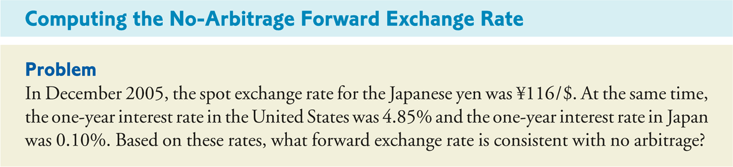
FX Forwards: Cash-and-Carry and Pricing
Letting T equal the number of years, the no-arbitrage forward rate for an
exchange that will occur T years in the future is
(1 + r )^{T}
F_{T} = S ×
$
(1 + r )^{T}
€

Slide 53
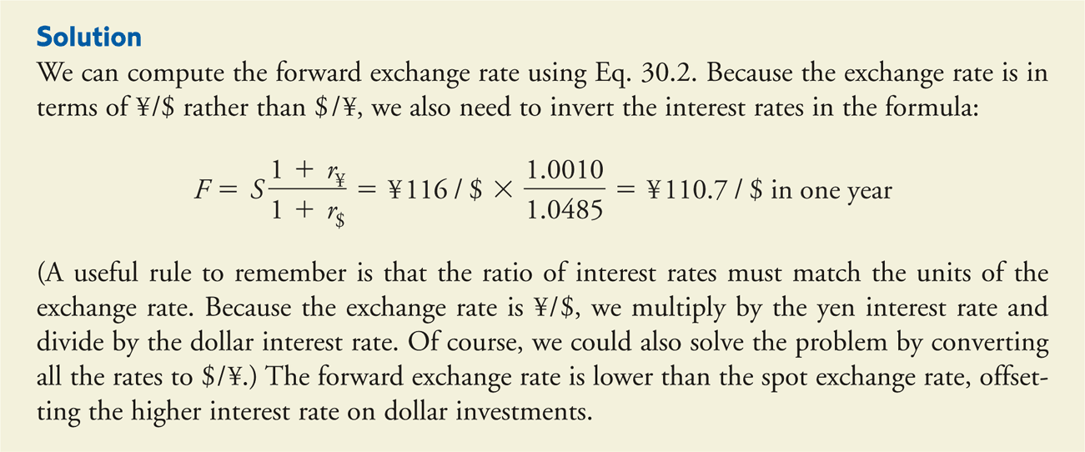
FX Forwards: Cash-and-Carry and Pricing

Slide 54
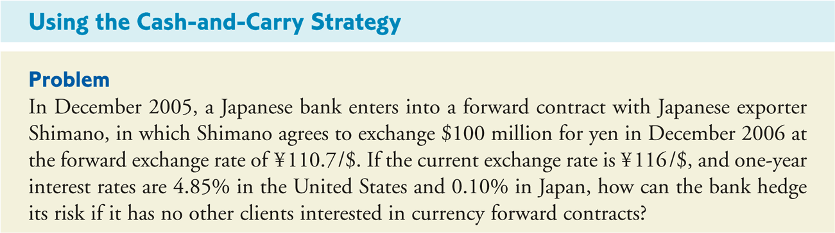
FX Forwards: Cash-and-Carry and Pricing
Advantages of Forward Contracts
  A forward contract is simple, requiring one transaction rather than three.
  Many firms are not able to borrow easily in different currencies and may pay a higher interest rate if their credit quality is poor.

Slide 55
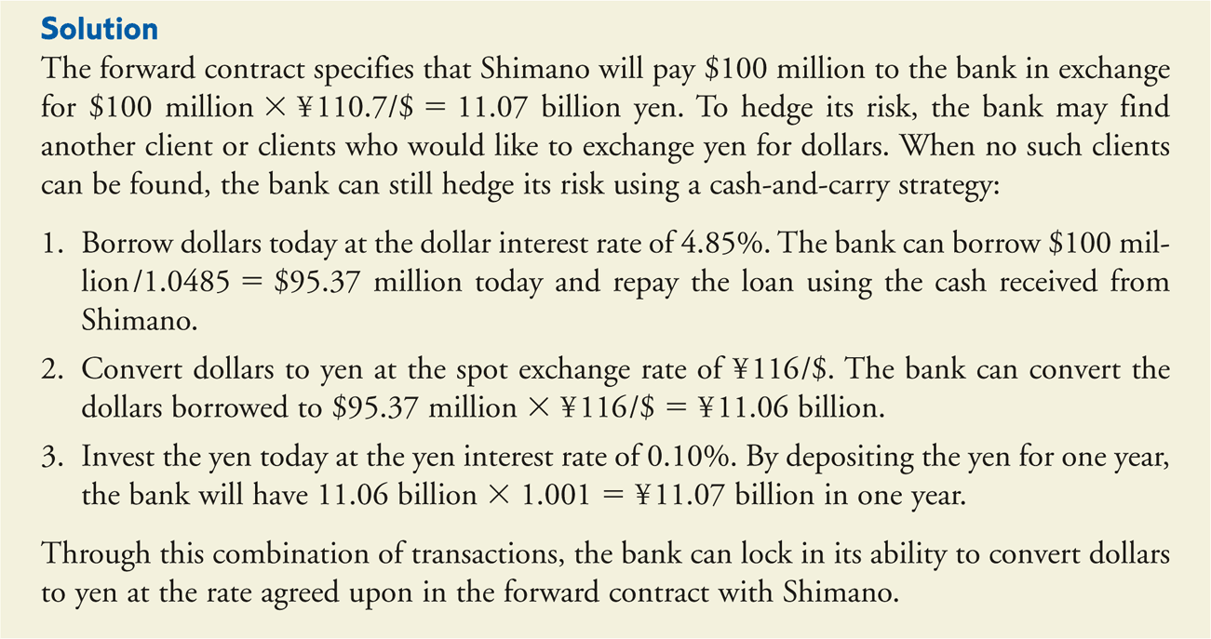
FX Forwards: Cash-and-Carry and Pricing

Slide 56
Currency forward
In fact, with covered IRP, the theoritical forward rate is the best estimation of the future spot! (see empirical evidence on www.ssrn.com)
The fair (or theoritical) forward price is a function of:
  The difference between the two interest rates
  The maturity
  The spot at T0 date

Slide 57
Currency forward
Pure application of covered IRP Theory
  Strong currencies (bullish) => low interest rates (low risk premium)
  Weak currencies (bearish) => high interest rates (higher risk premium to balance the bearish market)
Examples : speculation in a fixed exchange rate system : Asian crisis in 1997/98, or Agentina peso crisis (2001), FRF in 1993, GBP in 1992…

Slide 58
Forward Contracts summary (1)
Forward contracts: Typical OTC derivatives which involves fixing of rates (exchange rate, commodity price, etc.) in advance for delivery in future. Risk of adverse price movement is covered.
Forward contracts are specified at forward rates which are spot rates plus cost of carry (interest rate differential in case of foreign exchange forward)

Slide 59
Forward Contract (2)
Forward rate: spot rate + premium or – discount
Premium/discount: function of cost of carry (interest rate differential)
The currency with lower interest rate would be at a premium in future
Other factors affecting forward rates
  Demand and supply for forward currency
  Perception about the movement in the currency
  Political, fiscal and trade-related conditions in the country and for the currency

Slide 60
Futures (1)
Futures: A version of exchange traded forward contracts.
Standardized contracts as far as the quantity (amounts) and delivery dates (period) of the contracts.
Conveys an agreement to buy a specific amount of commodity or financial instruments at a particular price on a stipulated future date
An obligation on the buyer to purchase the underlying instrument and the seller to sell it

Slide 61
FX Forward: P&L Profile - Benefits and Disadvantages
Benefits
  Relatively low cost : no premium like for options, but credit spread charged to offset counterparty risk
  Hedging tool: protection against an adverse currency move (EUR appreciation)
  Planning tool: you know your cash flows in advance
  Customized product compared to Futures (tenor, amount, no margin)
  No liquidity risk (no margining)
Disadvantages
  Opportunity cost: no possibility to benefit from a favorable currency move (EUR devaluation)
  Cost is non transparent
  When interest rate differential is large (and spot expected to be stable), the premium is high and forward price might be expensive.

Slide 62
What is an Option?
Basic Definition:
  An option gives the buyer the right, but not the obligation, to buy or sell an underlying asset at a pre-specified price at or before an agreed upon point in the future against the payment of a premium.
  An option gives the seller (=the writer) the obligation to perform the terms of the option should the buyer decide to exercise the option.
Option = derivative asset = value depends on the value of the underlying asset
Underlying asset is the asset to be purchased or sold
  Stocks and stocks indices
  Commodities
  Bonds / interest rates (swaps)
  Currencies, Options, etc..
Options can be standardized and exchange traded or bilateral and tailor made contracts (OTC)

Slide 63
Basic Option Terminology
All options are either calls or puts.
  Call options:
    A call conveys the right, but not the obligation, to buy the underlying currency.
  Put options:
    A put conveys the right, but not the obligation, to sell the underlying
currency.
Currency option trades
  They have two sides as options quoted on foreign currency pairs include both a call and a put.
  Each transaction involves both the purchase of one currency and the sale of another:
› The purchased currency is the call side.
› The sold currency is the put side of the trade.

Slide 64
Basic Option Terminology
Underlying Currency The currency pair bought or sold
Notional Amount
Strike Price
Maturity
Expiration Date
Delivery Date
The amount of the underlying
The price at which the underlying may be bought or sold The length of time an option exists
The date which the option expires
The date which the underlying is delivered if the option is
exercised
The cost (upfront payment) in a particular currency
The decision by the owner of the option to buy or sell the
underlying
Exercisable only on the expiry date
Exercisable at any time prior to, and including, the expiry date
Option premium
Exercise
European style
American style

Slide 65
CURRENCIES OPTIONS
OPTION TO BUY OR OPTION TO SELL
CALL = OPTION TO BUY
PUT = OPTION TO SELL
ASYMMETRY ➔ 4 POSSIBILITIES
  BUY A CALL EUR/USD
  BUY A PUT EUR/USD
  SELL A CALL EUR/USD
  SELL A PUT EUR/USD

Slide 66
CURRENCIES OPTIONS
UNDERLYING ASSET IS THE ASSET TO BE PURCHASED OR SOLD
  STOCKS AND STOCKS INDICES
  COMMODITIES (agricultural, energy products)
  BONDS / INTEREST RATES
  CURRENCIES
  OPTIONS (compound options = options on options)
  REAL ASSETS (PROJECTS, FIRMS)
  …

Slide 67
Illustrating Options with Pay-Out Profiles
Break Even Rate
Break Even Rate
Long Call
Long Put
STRIKE
STRIKE
Break Even Rate
Break Even Rate
Short
Call
Short Put
STRIKE
STRIKE

Slide 68
How to know if you sell or buy a currency (short or long)?
Use the « + » and « - » system
  + : buy, option to buy, call
- : sell, option to sell, put

Slide 69
Underlying asset position with currency option
  UNDERLYING ASSET
  BUY A CALL EUR/PUT USD :
  BUY A PUT EUR/CALL USD :
  SELL A CALL EUR/PUT USD :
  SELL A PUT EUR/CALL USD :

Slide 70
EUR/USD OPTIONS HEDGING
ASSUMPTIONS
  SPOT PRICE = FORWARD = STRIKE = 1.00 EUR/USD
  EUROPEAN EXPORTER DEALING IN USD
  PAYMENT MATURITY : 3 MONTHS

Slide 71
EUR/USD OPTIONS
3 STRATEGIES TO MANAGE THE SITUATION
  NO HEDGING
  HEDGING WITH THE FORWARD MARKET : PRICE = 1.00 EUR/USD
  HEDGING WITH A CALL EUR / PUT USD
    MATURITY : 3 MONTHS (EUROPEAN)
    STRIKE = 1.00 EUR/USD
    PREMIUM = 2%

Slide 72
EUR/USD OPTIONS
RESULT = WITH CURRENCIES OPTIONS, YOU ARE ABLE :
  TO MANAGE THE CURRENCY VOLATILITY
  TO MANAGE CONDITIONAL OPERATIONS (CREDIT OR COUNTRY RISKS)

Slide 73
EUR/USD OPTIONS
ONLY INCONVENIENT = THE PREMIUM THE BUYER HAS TO PAY TO THE WRITER
==> ZPO : ZERO PREMIUM OPTION
  EXOTIC OPTIONS (1st generation)
  OBJECTIVE IS TO REDUCE THE COST OF HEDGING AND KEEP SOME FLEXIBILITY
  CREATED BY CITYBANK IN 1985

Slide 74
EUR/USD OPTIONS
How to choose the premium ? The objective is to link the premium to pay to chosen strike.
At The Money options (ATM) : strike equal to the market conditions (spot or forward).
In The Money options (ITM) : strike is better than the market conditions.
Out The Money options (OTM) : strike is defavourable compared to the market conditions

Slide 75
EUR/USD OPTIONS
EUROPEAN EXPORTER CASE (forward rate=1.00)
STRATEGY
  BUY CALL EUR/PUT USD STRIKE = 1.10
  SELL PUT EUR/CALL USD STRIKE = 0.90

Slide 76
EUR/USD OPTIONS
TENDER ZPO FOR LONG AND CONDITIONAL POSITION
  BUY CALL EUR/PUT USD STRIKE = 1.20
  SELL PUT EUR/CALL USD STRIKE = 1.00
  BUY PUT EUR/CALL USD STRIKE = 0.90

Slide 77
EUR/USD OPTIONS
OPTIONS CAN ALSO BE USED FOR SPECULATIVE STRATEGIES
EXAMPLE : STRADDLE WHICH CONSISTS IN
  BUYING A CALL EUR/PUT USD
  BUYING A PUT EUR/CALL USD
  SAME STRIKE / SHORT MATURITY
  AMERICAN OPTIONS

Slide 78
Options Combinations: Speculation
Options can also be used for speculative strategies
Long Straddle which consists in:
P&L
Spot at maturity
Buying a call EUR/put USD
Buying a put EUR/call USD
Same strike / short maturity
Potential loss is limited
Expectations of high volatility.
Short Straddle which consists in:
P&L
Spot at maturity
Selling a call EUR/put USD
Selling a put EUR/call USD
Same strike / short maturity
Potential gain is limited but loss unlimited
Expectations of low volatility.

Slide 79
EUR/USD OPTIONS
OTHER STRATEGIES : SPREAD
  VERTICAL SPREADS
    OPTIONS WITH DIFFERENT EXERCISE PRICES BUT OTHERWISE IDENTICAL
  HORIZONTAL SPREADS
    OPTIONS WITH DIFFERENT TIMES TO MATURITY BUT OTHERWISE IDENTICAL
  DIAGONAL SPREADS
    OPTIONS WITH DIFFERENT TIMES TO MATURITY AND DIFFERENT EXERCISE PRICES

Slide 80
Options Combinations
Other strategies : Spreads
Vertical spreads
  Options with different exercise prices but otherwise identical
Put spread Call spread
P&L
Spot at maturity
P&L
Spot at maturity
Horizontal spreads
  Options with different times to maturity but otherwise identical
Diagonal spreads
  Options with different times to maturity and different exercise prices

Slide 81
EUR/USD OPTIONS
OTHER SPECULATIVE STRATEGIES : SYNTHETIC OPTIONS
  SYNTHETIC LONG FUTURES
    BUY CALL EUR/USD AND SELL PUT EUR/USD
    SAME STRIKE
    BULLISH ANTICIPATIONS
  SYNTHETIC SHORT FUTURES
    BUY PUT EUR/USD AND SELL CALL EUR/USD
    SAME STRIKE
    BEARISH ANTICIPATIONS

Slide 82
EUR/USD OPTIONS
2nd GENERATION OF CURRENCIES OPTIONS
  AVERAGE RATE OPTIONS (ASIAN)
  LOOKBACK OPTIONS
  COMPOUND OPTIONS (OPTION ON OPTION)
  KNOCK IN AND KNOCK OUT OPTIONS ….

Slide 83
EUR/USD OPTIONS
CURRENCIES OPTIONS PRICING : SOME ELEMENTS
PREMIUM (W) = INTRINSIC VALUE + TIME VALUE
INTRINSIC VALUE
    IT ONLY EXISTS FOR ITM OPTIONS
    LINEAR FUNCTION DEPENDING ON THE DIFFERENCE BETWEEN THE STRIKE PRICE OF THE OPTION AND THE LEVEL OF THE UNDERLYING FORWARD OR SPOT

Slide 84

Option pricing: Time Value
Option
Value
We have seen the effect of current market conditions, in terms of intrinsic value, now let‟s see the effect of future market conditions:
Premium = Intrinsic value + Time value
Value
Time
Value
0.00
Time value is a function of two main variables:
1.40
Fwd EUR/USD
Implied Volatility: the markets expectation for future movement potential.
Time remaining to expiration (maturity of the option). At maturity, time value is zero (only the intrinsic value remains).

Slide 85
EUR/USD OPTIONS
TIME VALUE
  DIFFERENCE BETWEEN THE PREMIUM OF THE OPTION AND THE INTRINSIC VALUE
  FUNCTION OF
    THE IMPLIED VOLATILITY OF THE CURRENCIES
    THE MATURITY OF THE OPTION : THE LONGER IT IS THE MORE UNCERTAINTY WE HAVE

Slide 86
Option Pricing and Valuation
The total value (premium) of an option is equal to the intrinsic value plus time value.
Intrinsic value is the financial gain if the option is exercised immediately.
  For a call option, intrinsic value is zero when the strike price is above the market price
  When the spot price rises above the strike price, the intrinsic value become positive
  Put options behave in the opposite manner
  On the date of maturity, an option will have a value equal to its intrinsic value (zero time remaining means zero time value)
The time value of an option exists because the price of the underlying currency, the spot rate, can potentially move further and further into the money between the present time and the option’s expiration date.

Slide 87
EUR/USD OPTIONS
FACTORS INFLUENCING THE PRICE OF AN OPTION
  PRICE OF THE UNDERLYING ASSET
    POSITIVE ON THE CALL PREMIUM
    NEGATIVE ON THE PUT PREMIUM
  STRIKE PRICE
    NEGATIVE ON THE CALL PREMIUM
    POSITIVE ON THE PUT PREMIUM

Slide 88
EUR/USD OPTIONS
FACTORS INFLUENCING THE PRICE OF AN OPTION
  TIME TO MATURITY
    POSITIVE ON CALL PREMIUM
    POSITIVE ON PUT PREMIUM
  IMPLIED VOLATILITY
    POSITIVE ON CALL PREMIUM
    POSITIVE ON PUT PREMIUM

Slide 89
EUR/USD OPTIONS
FACTORS INFLUENCING THE PRICE OF AN OPTION
  INTEREST RATES
    POSITIVE ON CALL PREMIUM : WHY ?
      THE SELLER OF A CALL MUST PURCHASE A CERTAIN QUANTITY OF THE UNDERLYING ASSET TO COVER HIMSELF IN CASE OF EXERCISE. THE PURCHASE OF THE UNDERLYING ASSET MUST BE FINANCED
    NEGATIVE ON PUT PREMIUM

Slide 90
EUR/USD OPTIONS
EXAMPLE : CALL USD / PUT EUR WRITER (SELL USD / BUY EUR IF EXERCISED)
  TO HEDGE YOUR POSITION, YOU NEED TO BUY A CERTAIN AMOUNT OF USD (how much ????????????)
  TO DO THIS, YOU BORROW A CERTAIN AMOUNT OF EUR
  YOU SELL EUR/BUY USD ON THE SPOT.
  USD ARE INVESTED ON THE MONEY MARKET;
  SO (EVERYTHING BEING EQUAL) :
  => IF INTEREST RATES ON USD INCREASE, PREMIUMS FOR CALL USD/EUR DECREASE
  => IF INTEREST RATES ON EUR INCREASE, PREMIUMS FOR CALL USD/EUR INCREASE

Slide 91
EUR/USD OPTIONS
CURRENCIES OPTIONS PRICING IN PRACTICE
  MARKET PARAMETERS : INTEREST RATES, VOLATILITY, …
  CUSTOMER PARAMETERS : TIME TO MATURITY, STRIKE
  ==> STATISTICAL MODEL
  ==> RESULT = PREMIUM TO PAY/RECEIVE

Slide 92
EUR/USD OPTIONS
MODELS
  COX / ROSS / RUBINSTEIN : BINOMIAL MODEL.
  GARMANN / KOHLHAGEN 1982 : DERIVATED FROM THE BLACK AND SCHOLES FORMULA.

Slide 93
PART 2
INTERNATIONAL FINANCING

Slide 94
International Capital Markets
Consist of:
  International Money Markets
    Commercial banks
    Offshore markets
  International Debt (Bond) Markets
    Offshore (euro) bonds
    Foreign bonds
  Equity Markets

Slide 95
International Bond Markets
Two basic segments:
Foreign Bonds
  Issued by a non-resident and denominated in the currency of the country in which it is being offered.
    GE issuing a yen denominated bond in Japan
Eurobond (euro word is coming from the Cold War)
  Issued by a non-resident and denominated in a currency other than the currency of the country in which it is being sold.
    GE issuing a dollar denominated bond in Europe.

Slide 96
What is a bond?
A Bond is an “IOU” « I owe you » in which an investor, or number of investors, agrees to lend money to an issuer, for an agreed time, in return for a predetermined rate of interest
Investor
Investor
Interest
(Coupon)
Investor
Issuer
Bond
Investor
Bond Proceeds
Investor
Investor

Slide 97
Eurobond Data
In any given year, about 80% of the world’s international bonds are likely to be euro bonds (as opposed to foreign bonds).
  They are noted by the name of the currency in which they are denominated:
    eurodollar bonds,
    euroyen bonds,
    euroeuro bonds

Slide 98
Foreign Bond Data
Foreign bonds represent about 20% of the new international bond offerings in any year.
  They are noted by the country where they are issued and have taken on rather “unique” names:
    Yankee bonds (issued in the U.S.)
    Samurai bonds (issued in Japan)
    Bulldogs (issued in the United Kingdom)
    Matadors (issued in Spain)
    Kiwi bonds (issued in New Zealand)
They are usually issued because of attractive interest rates and then swapped out the issuing currency into a “home currency.”
  Especially true with regard to Samurai bonds today.

Slide 99
Characteristics of International Bonds
Bearer versus Registered Bonds
  Eurobonds are usually bearer bonds.
    Possession is evidence of ownership.
    Issuers does not keep ownership records.
    Offer privacy and anonymity to holders.
      Thus, carry a lower interest rate than registered bonds.
  Registered bonds:
    Owners name is recorded by issuer.
    Yankee bonds and U.S. corporate bonds must be registered.

Slide 100
Characteristics
Regulations
  Foreign bonds must meet the security regulations of the country in which they are issued.
    Yankee bonds must comply with 1933 Securities Act requiring full financial disclosure and the offering of a prospectus to potential public buyers.
    But not required of eurobond offerings in the U.S.
  Time and expense in bring a foreign bond to market has resulted in a general preference for eurobond offerings for global borrowers.
    U.S. shelf registration, or pre-registration, (rule 145) since 1982 has reduced the time issue.
    Private placements (rule 144A) since 1990 do not have to meet the full disclosure requirements of the 1933 Act.

Slide 101
Global Bonds
Refers to large international bonds simultaneously offered in different markets.
  May be issued in different currencies
    Deutsche Telekom $14.6 billion multicurrency (dollar, euro, pound, yen) issue
  Or same currency:
    AT&T $$8 billion U.S. dollar global offering
First offered in 1989
Usually sold throughout North America, Europe, and Asia.
Usually sold to institutional investors.
Follow the registration requirements of domestic bonds.

Slide 102
Types of International Bond Instruments
Straight Fixed Rate
  Most international bonds are of this type
  Designed maturity date,
  Fixed coupon payments (% of par value),
  Eurobond interest is typically paid annually,
    Less costly for issuers
  No options (e.g., convertibility) attached
  Entire issue brought to market at one time.
  U.S. dollar bonds the most popular
  Sometimes referred to as “plain vanilla” bonds!

Slide 103
International Bond Types
Euro-Medium Term Notes (Euro MTNs)
  Similar to straight fixed rate bonds in that they have a fixed maturity and carry a fixed coupon rate.
  Unlike a straight fixed rate bond, they are sold on a “continuous basis” through some prearranged period (called an issuance facility).
    Allows issuers to raise money as needed
  Generally carry maturities from less than 1 year out to 10 years.

Slide 104
International Bond Types
Floating Rate Notes (FRNs)
  Coupon rate is indexed to some reference rate.
    Usually LIBOR 3 or 6 months (London, 11AM)
  Coupon reset at time of interest payment for the next period.
    Coupon payments generally every 3 or 6 months.
  U.S. dollar and euro denomination dominate this market.

Slide 105
International Bond Types
Equity Related Bonds
  Convertible issues
    Fixed income bond which,
    Allows the holder to exchange the bond for a predetermined number of share of common stock.
    Carry lower interest rates than a straight only bond.
  Bonds with Equity Warrants
    Fixed income bond with,
    Call option (or warrant) feature which allows the holder to purchase a certain number of equity shares at a pre-stated price over a predetermined period of time.

Slide 106
International Bond Types
Zero Coupon Bonds
  Sold at a discount from face (par) value,
  Do not pay any coupon interest
  At maturity, holder receives full face (par) value.
  Return is represented by the difference between price and face value.
  Most popular currencies have been the U.S. dollar and Swiss franc.
  Especially attractive to Japanese investors as their tax laws treat the return as a tax free capital gain (and coupon payments are taxable)!

Slide 107
International Bond Types
Dual-Currency Bonds
  Fixed rate bond that pays interest in one currency, and
  Upon maturity, pays principal value in another currency.
    Popular among Japanese firms:
      Coupon payments in yen; principal repayment in dollars.
      Used by Japanese companies wanting to establish or expand U.S. based subsidiaries.
        Subsidiaries would generate the dollars needed to pay off the principal.

Slide 108
Placing Eurobonds
Lead Manager (major and submajors)
  Primary investment banking firm
    Lead manager of underwriting syndicate.
    Negotiate terms with the issuer, ascertain market conditions and timing.
    Put together the syndicate!
Underwriting Syndicate
  Group of investment banks, merchant banks, and commercial banks that will bring the issue to market
  Commit their own capital to buy the issue from the issuer (at a discount)!
    Underwriting spread is typically 2 to 2.5%!
Selling Group
  Includes the underwriting syndicate plus other institutions.
  Sell the bonds to the public

Slide 109
Characteristics of International Bond Market Instruments
Instrument
Frequency of Payment
Size of Coupon
Payoff at Maturity
Straight Fixed-Rate
Annual
Fixed
Currency of issue
Floating Rate Note
Every 3 or 6 months
Variable
Currency of issue
Convertible Bond
Annual
Fixed
Currency of issue
or conversion to equity shares.
Straight fixed rate with equity warrants
Annual
Fixed
Currency of issue
plus conversion to equity shares.
Zero
none
zero
Currency of issue
Dual Currency Bond
Annual
Fixed
Dual currency

Slide 110









SSA
Agence France Tresor, Caisse d'Amortissement de la Dette Sociale (CADES), Dutch State Treasury Agency, …
FIG
BNP Paribas, Goldman Sachs, BPCE, Nordea,
Santander, HSBC, …
Corporates
ISSUER TYPES:
Pfizer, General Electric, Renault, Apple, Publicis,…
“SELL SIDE”
FUNDING NEED
Equity
Holding of shares of stock
Income from dividends and capital gains
Stocks are typically outstanding indefinitely
Last claim against assets, paid only after all other
creditors are paid in case of bankruptcy
Origination
IPO (intro en bourse), equity offering, …
“CIB”
Syndicate
Subordinated debt (Tier1, Tier2…)
Debt
Holding of notes, bonds, certificates
Income from interest
Repayment of principal at maturity date
Absolute priority in the event of bankruptcy
Sales
Senior unsecured, Covered Bond, …
INVESTING NEED
Banks
Insurance
Societe Generale, BNP Paribas, Danske Bank, Citi, Deutsche Bank, ING , …
CNP Assurance, Predica, La Mondiale, Generali, Aviva, Swiss Life, Allianz, Groupama, MAIF, …
Funds
Schroeders, NAM,
Blackrock, PIMCO, …
INVESTOR
TYPES:
“BUY
SIDE”
Corporates,
Agencies,
Central Banks,
Pensions, Private Banks, …
5

Slide 111
Issuer A
CEO, CFO, …
…
Treasury team
Primary market
Issuer B
Issuer C
Funding dept
“SELL SIDE”
Regular contact for advisory (marketing, legal or regulatory) and monitoring issuance opportunites
Also involved:
PRIVATE
SIDE
GSCS
Origination
Swap desks
Working together for pricing updates and market monitoring and gathering info for marketing/advisory effort
Trading
Syndicate
Coverage
Working together when collecting/allocating orders and gathering info for marketing/advisory effort
Legal
Sales
Research
Collecting feedbacks/orders when new bond is priced and primary/secondary mkt advisory (switches, Private placements)
Secondary market
Middle Office &
Back Office
Investor 1
Portfolio Manager
PUBLIC
SIDE
…
Investor 2
Investor 3
Credit advisor
Risk dept
“BUY SIDE”
6

Slide 112
PART 3
COUNTRY RISK ANALYSIS
See EMBRATEL Case
And Prof. Campbell Harvey web site
https://people.duke.edu/~charvey/

